Slide 1

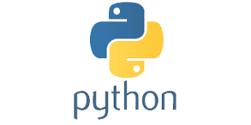
PYTHON
Lecture 2

Slide 2

Today’s Agenda
Version History , Downloading and Installing
Python
Version History
Python 2 v/s Python 3
Different Python Implementations
Downloading And Installing Python
Testing Python Installation

Slide 3
Python Version History
First released on Feb-20th -1991 ( ver 0.9.0)
Python 1.0 launched in Jan-1994
Python 2.0 launched in Oct-2000
Python 3.0 launched in Dec-2008
Python 2.7 launched in July 2010
Python 3.6.5 launched on March-28th-2018
Python 3.7 launched on June-27th -2018

Slide 4
The Two Versions Of Python
As you can observe from the previous slide , there are 2 major versions of Python , called Python 2 and Python 3
Python 3 came in 2008 and it is not backward compatible with Python 2
This means that a project which uses Python 2 will not run on Python 3.
This means that we have to rewrite the entire project to migrate it from Python 2 to Python 3

Slide 5
Some Important Differences
In Python 2
print “Hello Bhopal”
In Python 3
print(“Hello Bhopal”)
In Python 2
5/2 →2
5/2.0→2.5
In Python 3
5/2→ 2.5
The way of accepting input has also changed and like this there are many changes

Slide 6
The Two Versions Of Python
So to prevent this overhead of programmers , PSF decided to support Python 2 also.
But this support will only be till Jan-1-2020
You can visit https://pythonclock.org/ to see exactly how much time is left before Python 2 retires

Slide 7
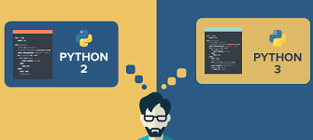
Which Version Should I Use ?
For beginners , it is a point of confusion as to which Python version they should learn ?
The obvious answer is Python 3

Slide 8
Why Python 3 ?
We should go with Python 3 as it brings lot of new features and new tricks compared to Python 2
Moreover as per PSF, Python 2.x is legacy, Python 3.x is the present and future of the language
All major future upgrades will be to Python 3 and , Python 2.7 will never move ahead to even Python 2.8

Slide 9
Various Implementations Of Python
The Python language has many popular implementations
The word implementation means the environment which provides support for the execution of programs written in the Python language.
As of now Python has around 26 implementations , but the most common are: Cpython , Jython , IronPython and PyPy

Slide 10
Difference Between Machine Code And ByteCode
Before proceeding further let us understand the difference between bytecode and machine code(native code).
Machine Code(aka native code)
Machine code is set of instructions that directly gets executed by the CPU.
Almost all the high level languages such as C, C++ translate the source code into executable machine code with the help of Compilers
This Machine code is then directly executed by the underlying Machine ( OS+CPU)

Slide 11
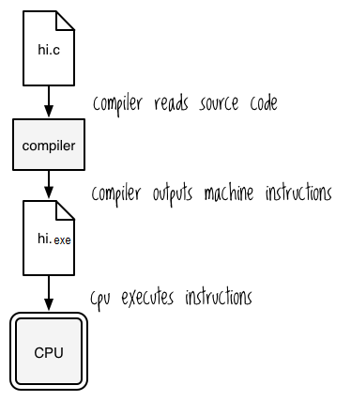
Difference Between Machine Code And ByteCode

Slide 12
Benefits And Drawbacks Of Machine Code
The benefit of machine code is that it runs very fast because it is in the native form i.e a form which is directly understandable to the CPU.
However the drawback is that it cannot run on another platform which is different than the platform on which the code was compiled.
In simple words , the .exe file of a C program compiled in Windows cannot run on Linux or Mac because every platform (OS+CPU) has it’s own machine code instruction set.

Slide 13

Benefits And Drawbacks Of Machine Code
C/C++
Source Code
Turbo
Compiler
Machine Code
Windows
Linux

Slide 14
Difference Between Machine Code And ByteCode
Bytecode
Bytecode is an intermediate code but it is different than machine code because it cannot be directly executed by the CPU .
So whenever the compiler of a language which supports bytecode compiles a program , the compiler never generates machine code.
Rather it generates a machine independent code called the “bytecode”.

Slide 15
Difference Between Machine Code And ByteCode
Now since this bytecode is not directly understandable to the platform(OS & CPU) , so another special layer of software is required to convert these bytecode instructions to machine dependent form .
This special layer is called VM or Virtual Machine.

Slide 16
Difference Between Machine Code And ByteCode
One such language which works on the concept of VM is Java.
Thus any such platform for which a VM (called JVM in java) is available can be used to execute a Java program irrespective of where it has been compiled.

Slide 17
Program Execution in JAVA
Source Code
Compiler
Byte Code
JVM
JVM
JVM
MacOS
Windows
Ubuntu

Slide 18
Benefits And Drawbacks Of ByteCode
The benefit of bytecode is that it makes our program platform independent i.e. we only have to write the program once and we can run it any platform provided there is a VM available on that platform
However the drawback is that it runs at a slower pace because the interpreter inside the VM has to translate each bytecode instruction to native form and then send it for execution to the CPU.

Slide 19
CPython
The default implementation of the Python programming language is CPython which is written in C language.
CPython is the original Python implementation and it is the implementation we will download from Python.org.
People call it CPython to distinguish it from other Python implementations
Also we must understand that Python is the language and CPython is it’s compiler/interpreter written in C language to run the Python code.

Slide 20
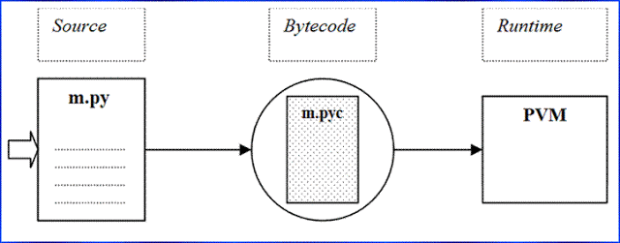
CPython
CPython compiles the python source code into intermediate bytecode, which is executed by the CPython virtual machine also called as the PVM .

Slide 21
Jython
The Jython system (originally known as JPython) is an alternative implementation of the Python language, targeted for integration with the Java programming language.
Jython compiles Python source code to Java bytecode and then sends this bytecode to the Java Virtual Machine (JVM).
Because Python code is translated to Java byte code, it looks and feels like a true Java program at runtime.

Slide 22
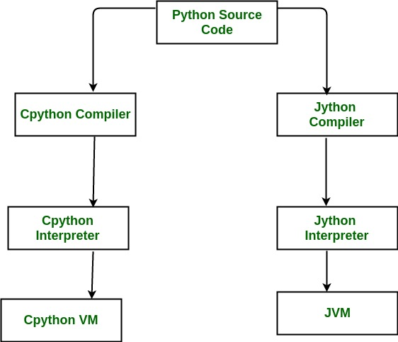
Jython

Slide 23
IronPython
A third implementation of Python, and newer than both CPython and Jython is IronPython
IronPython is designed to allow Python programs to integrate with applications coded to work with Microsoft’s .NET Framework for Windows.
Similar to Jython, it uses .Net Virtual Machine which is called as Common Language Runtime

Slide 24
PyPy
PyPy is an implementation of the Python programming language written in Python.
It uses a special compiler called JITC (just-in-time compilation).
PyPy adds JITC to PVM which makes the PVM more efficient and fast by converting bytecode into machine code in much more efficient way than the normal interpreter.

Slide 25
Downloading And Installing Python
We can use Python in 2 ways:
Without any IDE , i.e. by simply using notepad for writing the code and running it on command prompt
With an IDE like PyCharm , Spyder , Visual Studio Code etc
Initially we will learn and practice Python programs without any IDE and later on we will use PYCHARM

Slide 26
Downloading And Installing Python
Python’s downloading and installation is fairly easy and is almost same as any other software.
We can download everything we need to get started with Python from the Python website called http://www.python.org/downloads.
The website should automatically detect that we’re using Windows and present the links to the Windows installer.

Slide 27
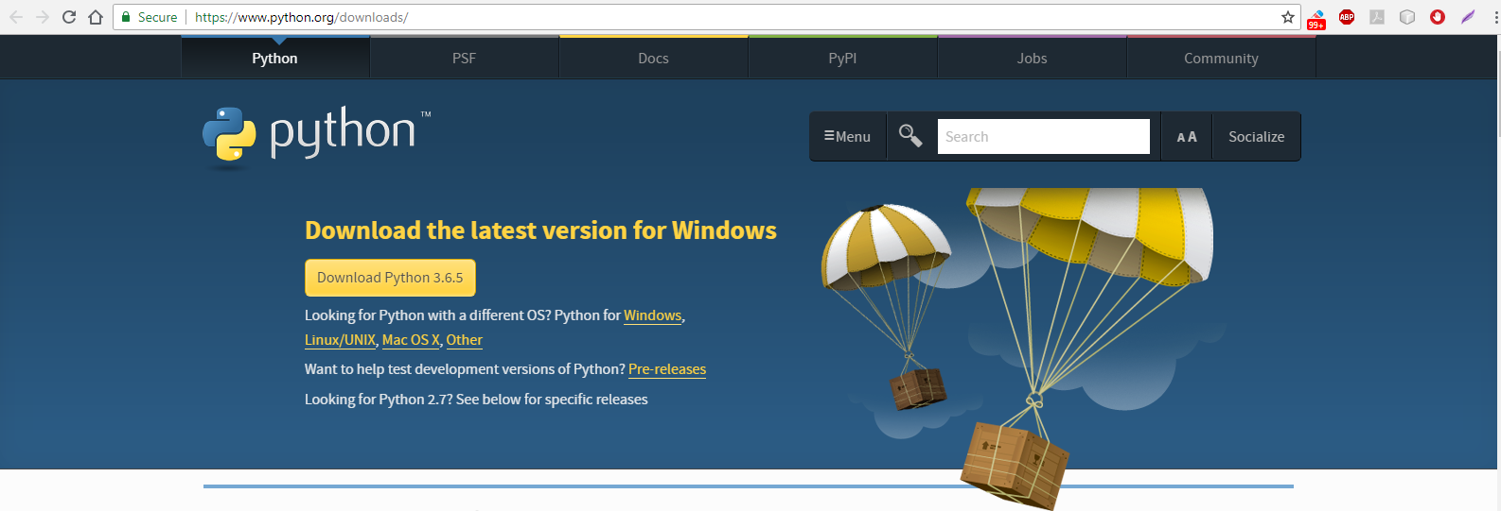
Downloading And Installing Python
If you have Windows 32 bit then download the installer by clicking on the button Download Python 3.6.5

Slide 28
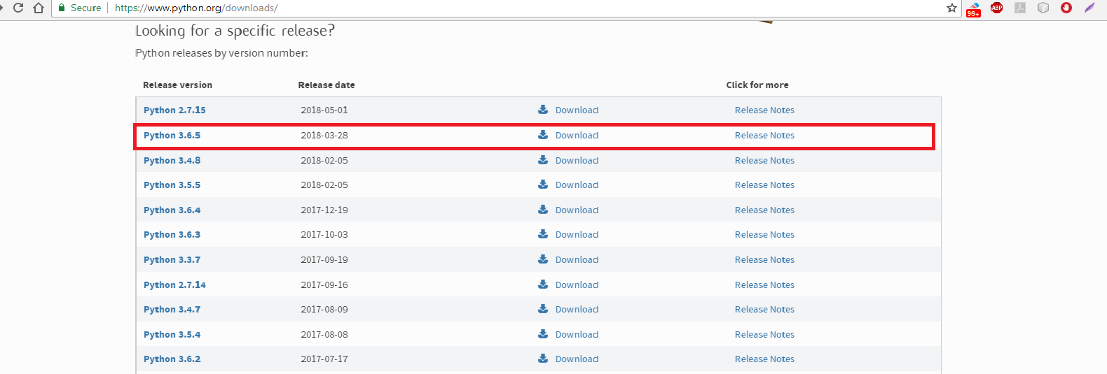
Downloading And Installing Python
But if you have windows 64 bit then scroll down and select python 3.6.5 from the list

Slide 29
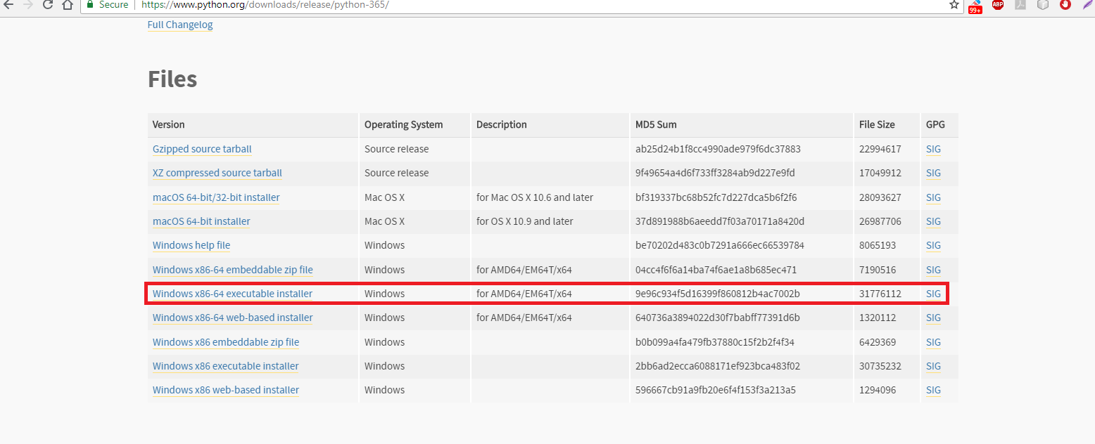
Downloading And Installing Python
Now go to the Files section and select windows x86-64 executable installer
This will download the installer

Slide 30
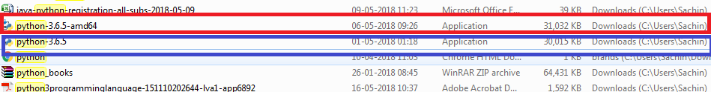
Downloading And Installing Python
Open the downloads folder and run the file python-3.6.5.exe (if you are on 32 bit) or python-3.6.5-amd64 (if you are on 64bit) by right clicking it and selecting run as administrator

Slide 31
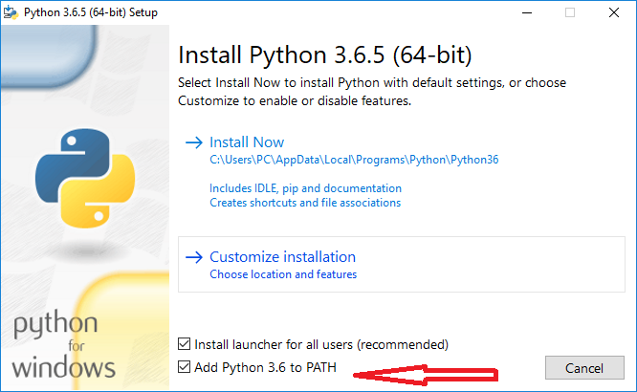
Downloading And Installing Python
The Python installer will start running . In the window that appears , do 2 things:
Click on the checkbox Add Python 3.6 to PATH
Select Install Now

Slide 32
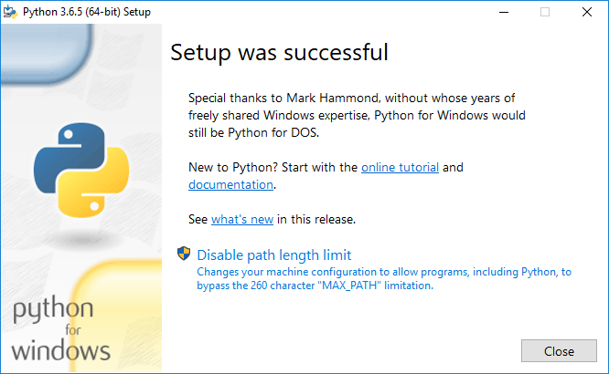
Downloading And Installing Python
Once the installation is over you will get SETUP WAS SUCCESSFUL message

Slide 33
Testing Python Installation
To verify that Python is installed and working correctly, do the following:
Open the command prompt
Type the command python --version
In the output we should see the python version number as shown in the next slide

Slide 34
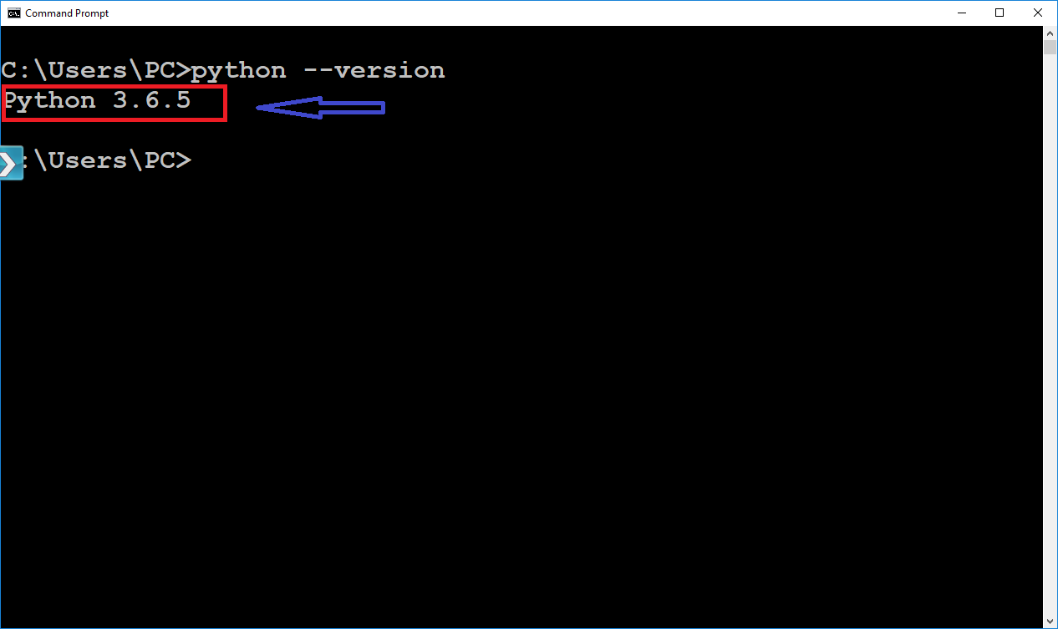
Testing Python Installation
To verify that Python is installed and working correctly, do the following:
Open the command prompt
Type the command Python –version
In the output we should see the python version number

